Slide 1
Chapter 10
How to work
with forms and validation

Slide 2
Objectives (part 1)
Applied
Use any of the jQuery selectors, methods, and event methods for working with forms and controls in a JavaScript application.
Knowledge
In general terms, describe the HTML5 controls and attributes for working with forms.
In general terms, describe the HTML5 attributes and CSS3 pseudo-classes for data validation.
Describe the use of these jQuery selectors for working with forms and controls: :input, :text, :radio, :checkbox, :submit, :reset, :button, :disabled, :enabled, :checked, and :selected.
Describe the use of the jQuery trim() method for working with text boxes.

Slide 3
Objectives (part 2)
Describe the use of these jQuery event methods for working with forms and controls: focus(), blur(), change(), select(), and submit().
Describe the use of these jQuery methods for triggering events: focus(), blur(), change(), select(), and submit().

Slide 4
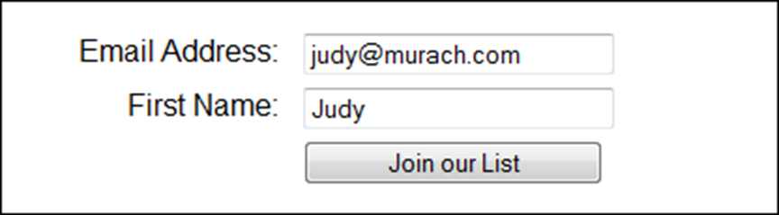
A form in a web browser

Slide 5
The HTML for the form
<form id="email_form" name="email_form"
action="join.php" method="get">
<label for="email_address">Email Address:</label>
<input type="text" id="email_address"
name="email_address"><br>
<label for="first_name">First Name:</label>
<input type="text" id="first_name"
name="first_name"><br>
<label>&nbsp;</label>
<input type="submit" id="join_list"
value="Join our List"><br>
</form>
The URL when the form is submitted
join.php?email_address=judy%40murach.com&first_name=Judy

Slide 6
Attributes of the form element
Attribute Description
name A name that can be referred to by client-side or server-side code.
action A URL that maps to the file that processes the data in the form.
method The HTTP method for submitting the form data. It is typically set to “get” or “post”. The default value is “get”.

Slide 7
Terms
form
control
field
submit button
reset button
data validation

Slide 8
Common HTML5 controls for input data
email
url
tel
number
range
date
time

Slide 9
The basic HTML5 attributes for working with forms
autofocus
placeholder

Slide 10
A form that uses some HTML5 controls and attributes
<form id="email_form" name="email_form" action="join.php"
method="get">
<label for="email_address">Email Address:</label>
<input type="email" id="email_address" name="email_address"
autofocus><br>
<label for="name">Name:</label>
<input type="text" id="name" name="name"><br>
<label for="phone">Phone Number:</label>
<input type="tel" id="phone" name="phone"
placeholder="999-999-9999"><br>
<label>&nbsp;</label>
<input type="submit" id="join_list"
value="Join our List"><br>
</form>

Slide 11
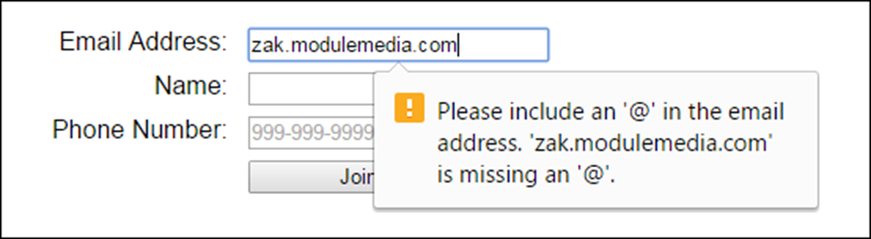
The form in Chrome with an error message for the email address

Slide 12
The HTML5 attributes for data validation
required
title
pattern
novalidate
autocomplete

Slide 13
CSS3 pseudo-classes for required, valid, and invalid fields
:required
:valid
:invalid

Slide 14
The HTML for a form that uses HTML5 attributes for data validation
<form id="email_form" name="email_form" action="join.php" method="get">
<label for="email_address">Email Address:</label>
<input type="email" id="email_address" name="email_address"
required autofocus autocomplete="off"><br>
<label for="name">Name:</label>
<input type="text" id="name" name="name" required><br>
<label for="phone">Phone Number:</label>
<input type="tel" id="phone" name="phone" required
pattern="\d{3}[\-]\d[3][\-]\d{4}"
title="Must be 999-999-9999"><br>
<label>&nbsp;</label>
<input type="submit" id="join_list"
value="Join our List"><br>
</form>

Slide 15
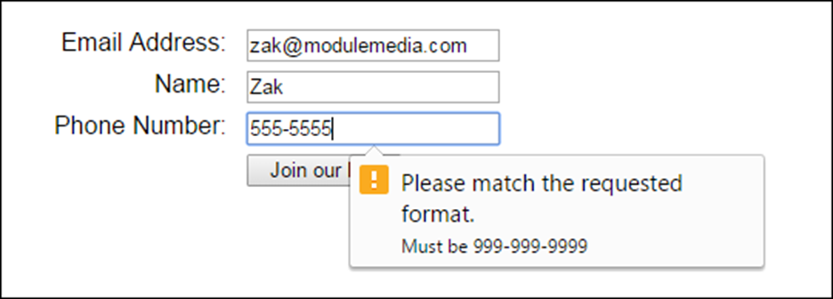
The form in Chrome with an error message for the phone field

Slide 16
Two of the reasons why you need JavaScript for data validation
The HTML5 input controls and attributes for data validation may not be implemented the same way by all browsers.
HTML5 is limited in the types of validation it can do.

Slide 17
The jQuery selectors for form controls
:input
:text
:radio
:checkbox
:file
:password
:submit
:reset
:image
:button
:disabled
:enabled
:checked
:selected

Slide 18
The jQuery methods for getting, setting, and trimming control values
val()
val(value)
trim()

Slide 19
How to get the value of a numeric entry from a text box
const age = parseInt($("#age").val());
How to trim the value of an entry and put it back into the same text box
const firstName = $("#first_name").val().trim();
$("#first_name").val(firstName);
How to get the value of the checked radio button in a group
const radioButton =
$("input[name='contact_by']:checked").val();
How to get an array of the selected options from a list
let selectOptions = [];
selectOptions = $("#select_list :selected");

Slide 20
The jQuery event methods for forms
focus(handler)
blur(handler)
change(handler)
select(handler)
submit(handler)

Slide 21
A handler that disables or enables radio buttons when a check box is checked or unchecked
$("#contact_me").change( () => { // change event for a check box
if ($("#contact_me").attr("checked")) {
$(":radio").attr("disabled", false)
} else {
$(":radio").attr("disabled", true)
}
});

Slide 22
The jQuery methods for triggering events
focus()
blur()
change()
select()
submit()

Slide 23
A handler that triggers the submit event after some data validation
$("#join_list").click( () => { // a regular button,
// not a submit button
// the data validation code goes here
$("#email_form").submit();
});

Slide 24
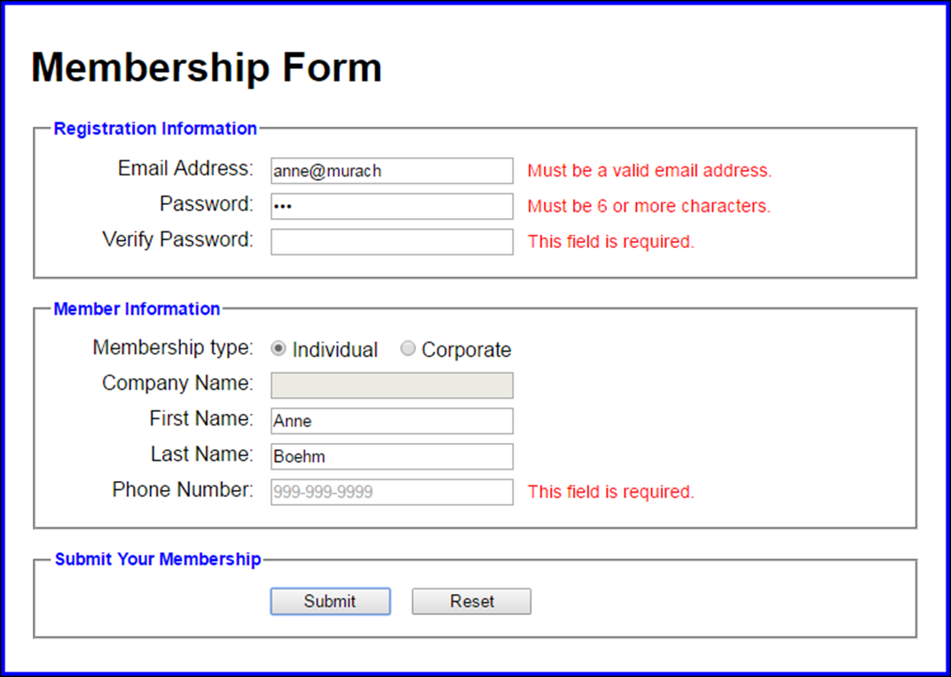
The Validation application

Slide 25
The HTML for the Validation application (part 1)
<form action="register.html" method="get"
name="member_form" id="member_form">
<fieldset>
<legend>Registration Information</legend>
<div>
<label for="email">Email Address:</label>
<input type="text" id="email" name="email">
<span>*</span>
</div>
<div>
<label for="password">Password:</label>
<input type="password" id="password" name="password"
placeholder="At least 6 characters" >
<span>*</span>
</div>
<div>
<label for="verify">Verify Password:</label>
<input type="password" id="verify" name="verify">
<span>*</span>
</div>
</fieldset>

Slide 26
The HTML for the Validation application (part 2)
<fieldset>
<legend>Member Information</legend>
<div>
<label>Membership type:</label>
<input type="radio" name="type" id="individual"
value="individual" checked>Individual
<input type="radio" name="type" id="corporate"
value="corporate">Corporate
</div>
<div>
<label for="company_name">Company Name:</label>
<input type="text" id="company_name" name="company_name"
disabled>
<span></span>
</div>
<!-- First and Last Name fields are omitted here -->
<div>
<label for="phone">Phone Number:</label>
<input type="text" id="phone" name="phone"
placeholder="999-999-9999">
<span>*</span>
</div>
</fieldset>

Slide 27
The HTML for the Validation application (part 3)
<fieldset id="buttons">
<legend>Submit Your Membership</legend>
<div>
<label>&nbsp;</label>
<input type="submit" id="submit" name="submit"
value="Submit">
<input type="reset" id="reset" name="reset"
value="Reset">
</div>
</fieldset>
</form>

Slide 28
The JavaScript and jQuery for the Validation application (part 1)
"use strict";
$(document).ready( () => {
// move focus to first text box
$("#email").focus();
// the handler for the change event of the radio buttons
$(":radio").change( () => {
const radioButton = $(":radio:checked").val();
if (radioButton == "corporate") {
$("#company_name").attr("disabled", false);
$("#company_name").next().text("*");
}
else {
$("#company_name").attr("disabled", true);
$("#company_name").next().text("");
}
});

Slide 29
The JavaScript and jQuery for the Validation application (part 2)
// the handler for the click event of the submit button
$("#member_form").submit( event => {
let isValid = true;
// validate the email entry with a regular expression
const emailPattern =
/\b[A-Za-z0-9._%+-]+@[A-Za-z0-9.-]+\.[A-Za-z]{2,4}\b/;
const email = $("#email").val().trim();
if (email == "") {
$("#email").next().text("This field is required.");
isValid = false;
}
else if ( !emailPattern.test(email) ) {
$("#email").next().text(
"Must be a valid email address.");
isValid = false;
}
else {
$("#email").next().text("");
}
$("#email").val(email);

Slide 30
The JavaScript and jQuery for the Validation application (part 3)
// validate the password entry
const password = $("#password").val().trim();
if ( password.length < 6) {
$("#password").next().text(
"Must be 6 or more characters.");
isValid = false;
}
else {
$("#password").next().text("");
}
$("#password").val(password);
// validate the verify password entry (not shown here)
// validate the company name entry
if ( !$("#company_name").attr("disabled")) {
const companyName = $("#company_name").val().trim();
if (companyName == "") {
$("#company_name").next().text(
"This field is required.");
isValid = false;
}

Slide 31
The JavaScript and jQuery for the Validation application (part 4)
else {
$("#company_name").next().text("");
}
$("#company_name").val(companyName);
}
// validate other text boxes (not shown here)
// prevent the submission of the form if any entries
// are invalid
if (isValid == false) {
event.preventDefault();
}
});
}); // end ready() handler

